Slide 1
FOREST COMBUSTION RECOGNITION
Using Artificial Intelligence
Smart Bridge-Remote Summer Internship Program
Developed by: Chandana Suthrala
Ravali Pollampally
Venkatesh Oggula
Srujana Balasani

Slide 2
TABLE OF CONTENTS
Introduction
Purpose
Block Diagram
Flow Chart
Software Designing
Experimental Investigation
Advantages and Disadvantages
Conclusion

Slide 3
INTRODUCTION
Fire Detection in most places employs equipment like temperature detectors, smoke detectors, thermal cameras etc. Which is expensive and not available to all. But, after the advent of advanced image processing and computer vision techniques, detection of fire may not require any equipment other than cameras. Due to this expeditious development in vision-based fire detection models, there is a particular inclination towards replacing the traditional fire detection tools with vision-based models. These models have many advantages over their hardware based counter parts like accuracy, more detailed view of the situation, less prone to errors, robustness towards the environment, considerably lower cost and the ability to work on existing camera surveillance systems.

Slide 4
PURPOSE
Forest combustion recognition is nothing but processing forest fire images and gives a alert message. This project is make use of numpy and ImageDataGenerator from python to extract the libraries from Machine Learning for the forest fire recognition. Secondly, to learn how to build model using Convolution neural network(CNN) machine learning algorithm. Finally, to predict whether the image is with fire or not using video analysis technique of combining the predictions from machine learning algorithms and giving the alert message to the email address.

Slide 5
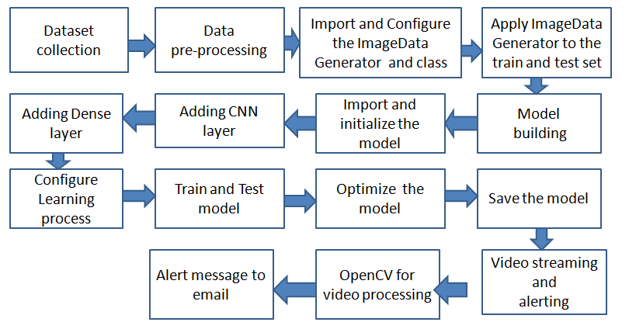
BLOCK DIAGRAM

Slide 6
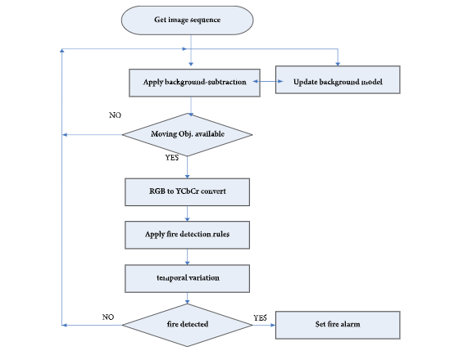
FLOW CHART

Slide 7
SOFTWARE DESIGNING
● Jupyter Notebook Environment.
● Machine Learning Algorithms.
● Python (Numpy, ImageDataGenerator, Model building, CNN layers,
Video preprocessing algorithms).
We developed this forest fire prediction by using the Python language which is a interpreted and high level programming language and using the Machine Learning algorithms. for coding we used the Jupyter Notebook environment of the Anaconda distributions, it is an integrated scientific programming in the python language.

Slide 8
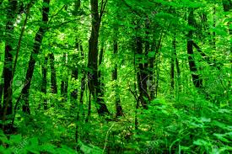
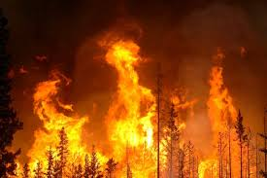
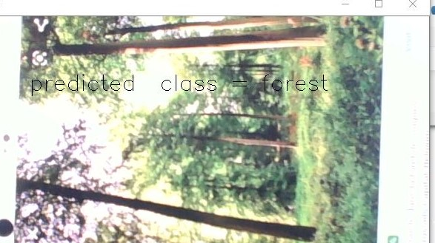
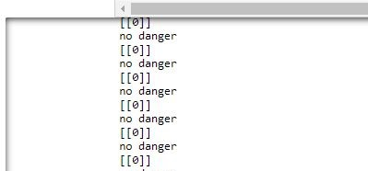
EXPERIMENTAL INVESTIGATION
In this project we created a dataset with collection of forest images with fire and without fire. Those collection of forest dataset images are given below
Next step is to build model. After that video streaming will detects the images. Those collection of forest outputs are given below
(a)Predicted as forest without fire
(b)Program output when no fire was detected

Slide 9
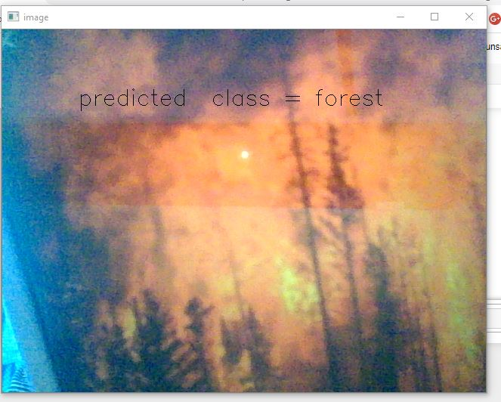


Conti..
(a) Predicted as forest with fire
(b) Program output when fire was detected
(c) Email was send

Slide 10
ADVANTAGES
Proposed methods are very convenient and can easily and usefully be adapted to current forest fire detection systems.
less expensive, Simple, fast and easy to implement.
low consumption.
Reduce death rate.
DISADVANTAGE
Determining climate conditions, daily temperature differences, Seasonal normal temperature values etc.. are problematic.
User can make mistakes while typing a message format.
Netwrok issues.

Slide 11
CONCLUSION
This project proposes an effective forest fire detection method using CNN and max pooling operation techniques including movement containing region detection based on color segmentation. The results show that the proposed algorithm achieves good detection rates. These results indicate that the proposed method is accurate and can be used in automatic forest fire-alarm systems.

Slide 12
THANK YOU !

